Slide 1
Personal Computer Applications
Lecture 09
HNDIT1101

Slide 2
What is a presentation?
A presentation is a visual aid to a speaker/presenter who is explaining some matter to a large audience interactively. There are several equipment's and several forms of materials, which are used when doing a presentation.

Slide 3
What is a presentation?…
Paper based presentations
Transparencies and Overhead Projector
Color Slides.
Computer and Multimedia Projector

Slide 4
Computer Based Presentation Tools
There are some application software, which are designed for presentation purposes. MS Power Point is the popular one. Several application software are listed below.
    Microsoft Power Point
    Harvard Graphics
    Showcase
    Aldus presentation

Slide 5
Advantages of computer Based Presentation
Easy preparation of slides
  It is very easy and fast to create slides on the computer screen rather than transparencies and markers. Adding, deleting, Changing the order of the slide is easier.
Easy to maintain a standard format
  In PowerPoint you can select from many stylish layouts with common color schemes and consistent font styles and sizes to all the slides of the presentation. It helps to make the presentation more professional.
Animation
  Text, Graphics can be added to the slides easily. It is possible to add animations to both text and graphics.

Slide 6
Advantages of computer Based Presentation………
Multimedia features can be embedded
  Multimedia features(Sound, video, voice, music) can be embedded to the slides and it makes the presentation more live.
Presentation to publish on the World Wide Web quickly
  PowerPoint takes care of the details of converting your slide shows to HTML and it automatically adds navigation buttons and homepage that has links to each of your slides.
Facility to add additional notes
  There is an opportunity to add additional notes to a slide in MS PowerPoint. It is useful for the speaker

Slide 7
Advantages of computer Based Presentation………
Easy navigation
  MS Power Point facilitates to define links among the slide and any other files or to URL(universal resource locator)

Slide 8
Describe guideline to design an effective presentation
Outlines
Slide Structure
Fonts
Colour
Background
Graphs
Spelling and Grammar
Conclusions
Questions

Slide 9
Outline
Make your 1st or 2nd slide an outline of your presentation
Follow the order of your outline for the rest of the presentation
Only place main points on the outline slide
  Ex: Use the titles of each slide as main points

Slide 10
Slide Structure – Good
Use 1-2 slides per minute of your presentation
Write in point form, not complete sentences
Include 4-5 points per slide
Avoid wordiness: use key words and phrases only

Slide 11
Slide Structure - Bad
This page contains too many words for a presentation slide. It is not written in point form, making it difficult both for your audience to read and for you to present each point. Although there are exactly the same number of points on this slide as the previous slide, it looks much more complicated. In short, your audience will spend too much time trying to read this paragraph instead of listening to you.

Slide 12
Slide Structure – Good
Show one point at a time:
  Will help audience concentrate on what you are saying
  Will prevent audience from reading ahead
  Will help you keep your presentation focused

Slide 13
Slide Structure - Bad
Do not use distracting animation
Do not go overboard with the animation
Be consistent with the animation that you use

Slide 14
Fonts - Good
Use at least an 18-point font
Use different size fonts for main points and secondary points
  this font is 24-point, the main point font is 28-point, and the title font is 36-point
Use a standard font like Times New Roman or Arial

Slide 15
Fonts - Bad
If you use a small font, your audience won’t be able to read what you have written
CAPITALIZE ONLY WHEN NECESSARY. IT IS DIFFICULT TO READ
Don’t use a complicated font

Slide 16
Colour - Good
Use a colour of font that contrasts sharply with the background
  Ex: blue font on white background
Use colour to reinforce the logic of your structure
  Ex: light blue title and dark blue text
Use colour to emphasize a point
  But only use this occasionally

Slide 17
Colour - Bad
Using a font colour that does not contrast with the background colour is hard to read
Using colour for decoration is distracting and annoying.
Using a different colour for each point is unnecessary
  Using a different colour for secondary points is also unnecessary
Trying to be creative can also be bad

Slide 18
Background - Good
Use backgrounds such as this one that are attractive but simple
Use backgrounds which are light
Use the same background consistently throughout your presentation

Slide 19
Background – Bad
Avoid backgrounds that are distracting or difficult to read from
Always be consistent with the background that you use

Slide 20
Graphs - Good
Use graphs rather than just charts and words
  Data in graphs is easier to comprehend & retain than is raw data
  Trends are easier to visualize in graph form
Always title your graphs

Slide 21
Graphs - Bad

Slide 22
Graphs - Good

Slide 23
Graphs - Bad

Slide 24
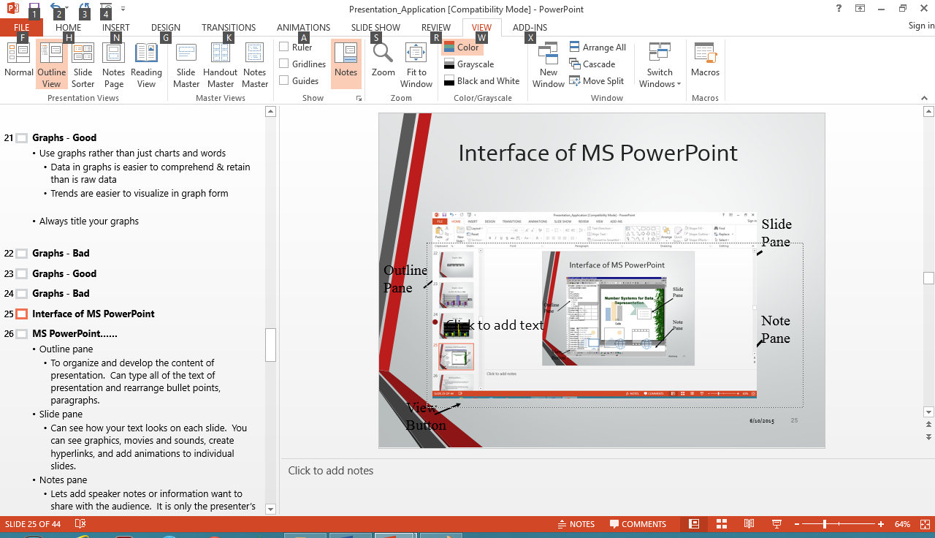
Interface of MS PowerPoint
Slide
Pane
Outline
Pane
Note
Pane
View Button

Slide 25
MS PowerPoint……
Outline pane
  To organize and develop the content of presentation. Can type all of the text of presentation and rearrange bullet points, paragraphs.
Slide pane
  Can see how your text looks on each slide. You can see graphics, movies and sounds, create hyperlinks, and add animations to individual slides.
Notes pane
  Lets add speaker notes or information want to share with the audience. It is only the presenter’s use.
Notes:
dgffhghgh

Slide 26

Presentation views

Slide 27
Different views
Normal view-can work on one slide at a time or organize the structure of all the slides.
Outline view-Use to enter your text ideas in an outline form
Slide sorter view – This view lets you see several slides at once, and allows you select, reorganize, or change attributes of multiple slides.

Slide 28
Different view
Slide show view – Use to play the slide show and press “Ese” to stop the play
Notes Page - See how your presentation will look when printed out with notes. Each page will contain one slide and its speaker notes, which you can edit in this view.
Reading view - Play your slide show in the PowerPoint window to see animations and transitions without switching to a full-screen slide show.

Slide 29
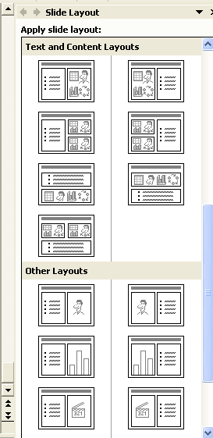
About layouts
"Layout" refers to the way things are arranged on a slide.
A layout contains
  Placeholders, which in turn hold text such as titles and bulleted lists and slide content such as tables, charts, pictures, shapes, and Clip arts.
A layout with three placeholders: for title, a bulleted list, and content such as a table, diagram, chart, or clip art.

Slide 30
Insert a Chart
It is also possible to add a chart to a slide.
Path: Insert/Chart or click on the chart button
The vertical bar chart is one of the most commonly used data chart types and it is the default chart type. There is a datasheet, attached to the chart and it shows you sample data to aid you in entering your own data.

Slide 31
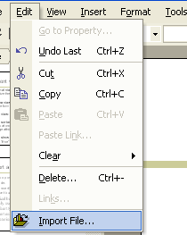
Import Chart Data from Excel
You can import data from MS Excel spreadsheets, or from other common file types, like text (.txt) files. If you are importing Excel file, you can only import one sheet for any individual graph.
The steps for importing data from Excel include.
  Open the chart datasheet
  Select the upper left cell where you want the data block to appear
  Select EDIT, Import File
  Select the file to import and click (open).

Slide 32
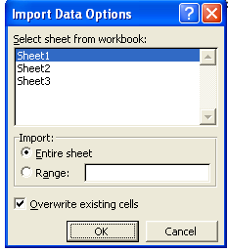
The “Import Data Options” dialog box will appear.
When you create a new chart in PowerPoint, Microsoft Graph opens and a chart is displayed with its associated data in a table called a datasheet. You can enter your own data on the datasheet, import data from a text file or Lotus 1-2-3 file, import or insert a Microsoft Excel worksheet or chart, or paste data from another program.

Slide 33

Adding a table
Do one of the following:
Insert a basic table
  On the Standard toolbar, click Insert Table .
  Point to select the number of rows and columns you want and then click.
Draw a more complex table
  If the Tables and Borders toolbar is not displayed, click Tables and Borders on the Standard toolbar.
  Click Draw Table .
  The pointer changes to a pencil.
  To define the outer table boundaries, drag diagonally to the size you want. Then drag to create the column and row boundaries.
  To erase a line, click Eraser and then click the line.

Slide 34
Movies and Sounds
It is possible to insert sound/music or movies file to a slide.
Sound:-path
  Insert → Movies and Sounds→ from file
Movies :-path
  Insert →Movies and Sounds→ from file

Slide 35


Movies and Sounds
Record a sound or voice comment on a single slide
To record and hear a sound or comment, you need a sound card, microphone, and speakers.
Display the slide you want to add a sound or comment to.
On the Insert menu, point to Movies and Sounds, and then click Record Sound.
To record the sound or voice comment, click Record .
When you are finished recording, click Stop .
In the Name box, type a name for the sound, and then click OK.
A sound icon appears on the slide.

Slide 36
Hyperlinks and action buttons
In Microsoft PowerPoint, a hyperlink is a connection from a slide to another slide, a custom show, a Web page, or a file. The hyperlink itself can be text or an object such as a picture, graph, shape, or WordArt. An action button is a ready-made button that you can insert into your presentation and define hyperlinks for.
Hyperlink Previous
Action button
  If the link is to another slide, the destination slide is displayed in the PowerPoint presentation.
  If the link is to a Web page, network location, or different type of file, the destination page or file is displayed in the appropriate application or in a Web browser.
  In PowerPoint, hyperlinks become active when you run your presentation, not when you are creating it.

Slide 37
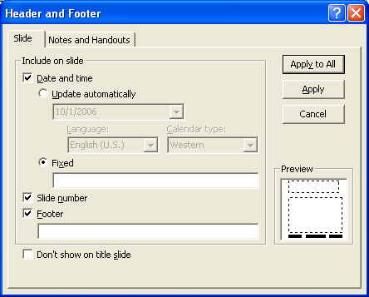
Insert Date/Time and Slide number
It is possible to add date/time or slide number to an individual slide. First positions the curser point in a text placeholder or text box where want it to go.

Slide 38
Insert Header and Footer
Inserting header and footer, it is possible to add date/time, slide numbers or any other text to an individual slide or all the slides in the presentation.
Path:- View→ Header and Footer

Slide 39
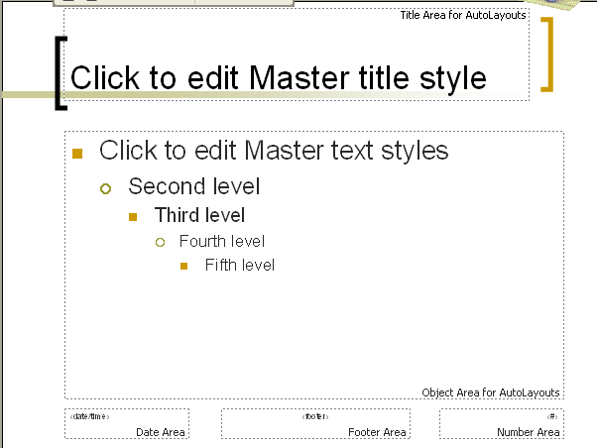
Slide Master
The slide master is an element of the design template that stores information about the template, including font styles, placeholder sizes and positions, background design, and color schemes.
The slide master's purpose is to let you make a global change — such as replacing the font style — and have that change reflected on all the slides in your presentation.

Slide 40
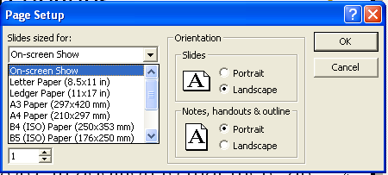
Printing options
A variety of items can be printed through PowerPoint. This option has same features such as print All, Current Slide or Selected Slides like MS Word. In addition to that there are four other options to get printouts.

Slide 41
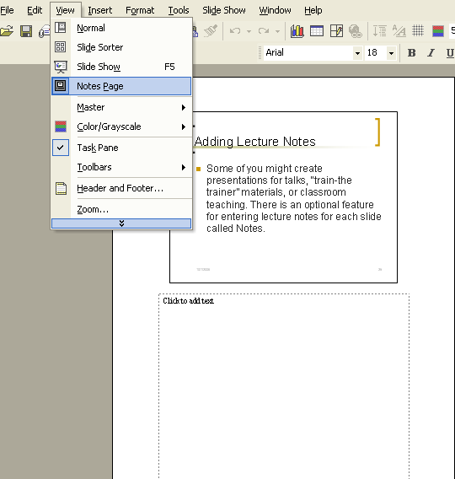
Adding Lecture Notes
Some of you might create presentations for talks, “train-the trainer” materials, or classroom teaching. There is an optional feature for entering lecture notes for each slide called Notes.

Slide 42
END

